Slide 1

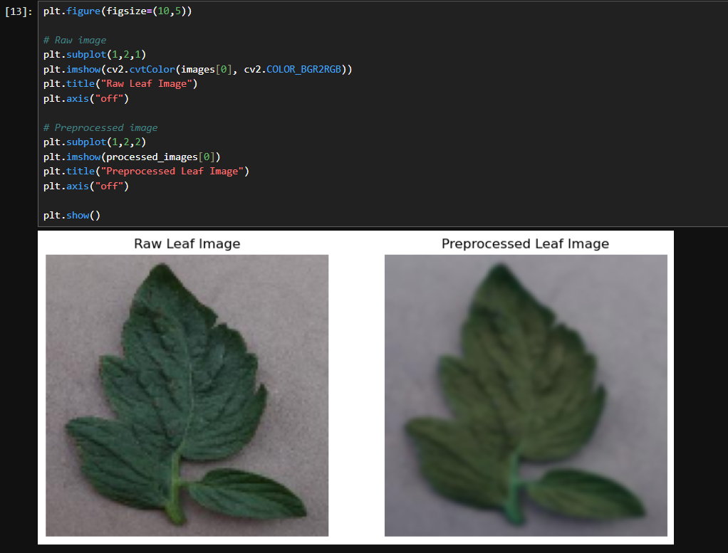
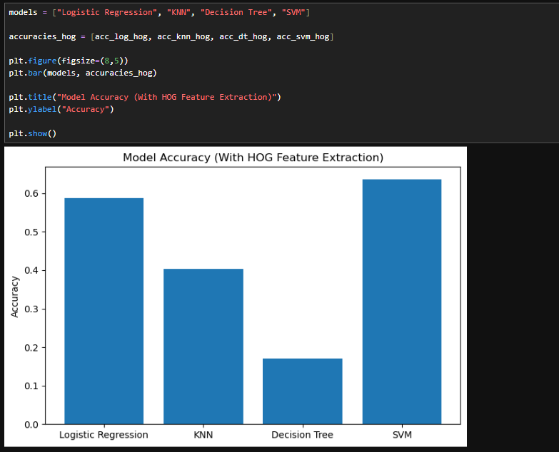
Plant Disease Detection
Rukhaany Lakshmipathy(24BCE1381) &
Yunus Mohammed Sabir(24BCE1385)
Dr. Pattabiraman
SCOPE
Github link: https://github.com/rukhaanylakshmipathy-crypto/plant-disease-detection
INTRODUCTION
Currently, in the modern world, plant diseases play a major role in reducing agricultural productivity. A huge number of plants get destroyed every year because of the late detection of these diseases.
The reasons for undertaking this project include the following:
• Plant diseases cause a reduction in crop production
• Early detection prevents extensive damage from occurring
• Detection manually is a tedious process requiring expertise
To achieve automatic detection of these diseases in plants, different image processing techniques are applied along with algorithms like Logistic Regression, KNN, Decision Tree, SVM, and CNN.
Objectives
• Identify plant diseases using leaf images • Apply preprocessing techniques to improve image quality • Perform segmentation to extract diseased regions • Analyze performance of machine learning models • Compare models with and without feature extraction • Improve accuracy using deep learning (CN
SCOPE of the project
• Facilitates automatic disease diagnosis of plants based on leaf images
• Minimizes reliance on expert-based visual inspection
• Assists in the timely recognition of disease to avoid crop damage
• Can be expanded to real-time application via mobile/web interfaces
• Suitable for different types of plant diseases based on images
• May be enhanced using deep learning techniques for greater precision
• Beneficial for farmers, agricultural scientists, and monitoring systems
methodology
Preprocessing
Preprocessing techniques like resizing, normalization, and Gaussian blur are applied to the images in the dataset to standardize input and reduce noise for better prediction.
Segmentation
Segmentation techniques such as HSV color segmentation and Otsu thresholding etc are used to isolate diseased regions.
Feature Extraction
HOG (Histogram of Oriented Gradients) is used to extract features like edges and textures from images.
Architecture
Used PlantVillage dataset:
• Contains images of healthy and diseased plant leaves • Multiple classes such as Tomato Early Blight, Late Blight, Healthy leaves • Approximately 150 images per class used for training
Machine learning algorithms used:
• Logistic Regression • K-Nearest Neighbors (KNN) • Decision Tree • Support Vector Machine (SVM)
Deep learning model:
• Convolutional Neural Network (CNN)
Results and discussion
Among the basic models, SVM had the highest accuracy. From the results, it was clear that preprocessing enhances data quality, helping to make a more accurate decision about the disease condition of a given leaf. The accuracy for CNN before enhancing images was about 38%, but after enhancing it went up to 78%. Hence image pre-processing and image enhancement techniques are important.
Conclusion
This project demonstrates that plant disease detection can be effectively achieved using image processing and machine learning techniques.
It was observed that: • Proper preprocessing is important • Feature extraction improves traditional models • CNN performs better than basic models
References
This project demonstrates that plant disease detection can be effectively achieved using image processing and machine learning techniques.
It was observed that: • Proper preprocessing is important • Feature extraction improves traditional models • CNN performs better than basic models
Datasets
Data Exploration
Deep Net
NORMAL IMAGE VS PREPROCESSED IMAGE
Diseased plant or not
Machine Learning Algorithm
Feature Extraction
ACCRACY COMPARISON OF ALL 4 BASIC MODELS

